Slide 1
Chapter 1:
Introduction to Computers and Java

Slide 2
Chapter Topics
Chapter 1 discusses the following main topics:
  Introduction
  Why Program?
  Computer Systems: Hardware and Software
  Programming Languages
  What Is a Program Made Of?
  The Programming Process
  Object-Oriented Programming
1-<number>

Slide 3
Java History
1991 - Green Team started by Sun Microsystems.
*7 Handheld controller for multiple entertainment systems.
There was a need for a programming language that would run on various devices.
Java (first named Oak) was developed for this purpose.
1-<number>

Slide 4
Introduction
Java enabled web browser (HotJava) demonstrated at 1995 Sun World conference.
Java incorporated into Netscape shortly after.
Java is “cross platform”, meaning that it can run on various computer operating systems.
1-<number>

Slide 5
Java Applications and Applets
Java programs can be of two types:
  Applications
    Stand-alone programs that run without the aid of a web browser.
    Relaxed security model since the user runs the program locally.
  Applets
    Small applications that require the use of a Java enabled web browser to run.
    Enhanced security model since the user merely goes to a web page and the applet runs itself.
1-<number>

Slide 6
Why Program?
Computers are tools that can be programmed to perform many functions, such as:
Computers are versatile because they can be programmed.
Computer Programmers implement programs that perform these functions.
  spreadsheets
  databases
  word processing
  games
  etc.
1-<number>

Slide 7
Why Program?
Aspects of a computer program that must be designed:
  The logical flow of the instructions
  The mathematical procedures
  The layout of the programming statements
  The appearance of the screens
  The way information is presented to the user
  The program’s “user friendliness”
  Manuals, help systems, and/or other forms of written documentation.
1-<number>

Slide 8
Why Program?
Programs must be analytically correct as well.
Programs rarely work the first time they are programmed.
Programmers must perform the following on a continual basis:
  analyze,
  experiment,
  correct, and
  redesign.
Programming languages have strict rules, known as syntax, that must be carefully followed.
1-<number>

Slide 9
Computer Systems: Hardware
Computer hardware components are the physical pieces of the computer.
The major hardware components of a computer are:
  The central processing unit (CPU)
  Main memory
  Secondary storage devices
  Input and Output devices
1-<number>

Slide 10
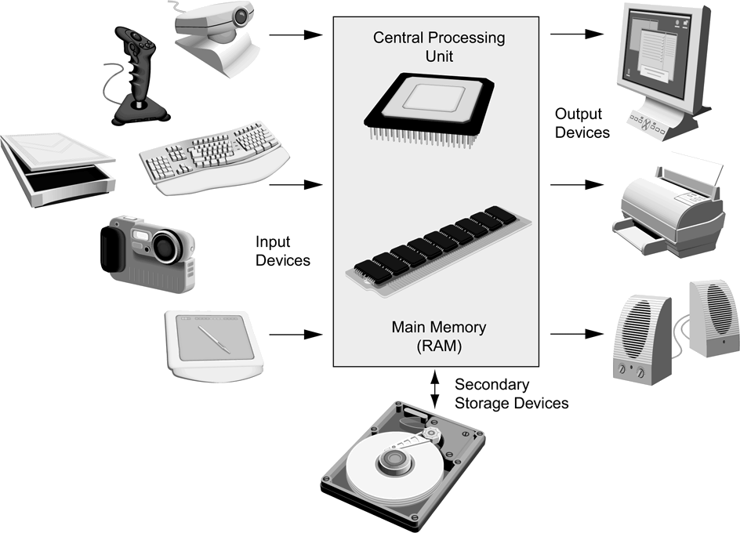
Computer Systems: Hardware
1-<number>

Slide 11
Computer Systems: Hardware
Central Processing Unit
CPU
Arithmetic
Logic
Unit
Instruction (input)
Result (output)
Control
Unit
1-<number>

Slide 12
Computer Systems: Hardware
Central Processing Unit
  The CPU performs the fetch, decode, execute cycle in order to process program information.
The CPU’s control unit fetches, from main memory,
the next instruction in the sequence of program instructions.
Fetch
The instruction is encoded in the form of a number. The control unit decodes the instruction and generates an electronic signal.
Execute
Decode
The signal is routed to the appropriate component of the computer (such as the ALU, a disk drive, or some other device). The signal causes the component to perform an operation.
1-<number>

Slide 13
Computer Systems: Hardware
Main Memory
Commonly known as random-access memory (RAM)
RAM contains:
  currently running programs
  data used by those programs.
RAM is divided into units called bytes.
A byte consists of eight bits that may be either on or off.
1-<number>

Slide 14
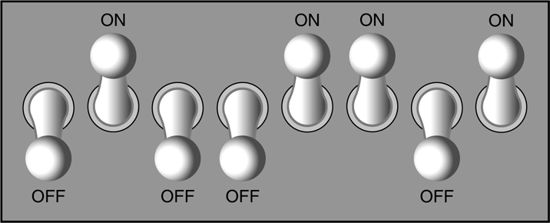
Computer Systems: Hardware
Main Memory
1
1
1
1
A bit is either on or off:
  1 = on
  0 = off
The bits form a pattern that represents a character or a number.
Each byte in memory is assigned a unique number known as an address.
RAM is volatile, which means that when the computer is turned off, the contents of RAM are erased.
0
0
0
0
1-<number>

Slide 15
Computer Systems: Hardware
Main Memory
Main memory can be visualized as a column or row of cells.
0x000
A section of memory is called a byte.
0x001
1
0
1
0
1
0
1
0
A byte is made up of 8 bits.
0x002
0x003
0x004
0x005
A section of two or four bytes is often called a word.
0x006
0x007
1-<number>

Slide 16
Computer Systems: Hardware
Secondary Storage Devices
Secondary storage devices are capable of storing information for longer periods of time (non-volatile).
Common Secondary Storage devices:
  Hard drive
  Floppy drive
  CD RW drive
  CD ROM
  DVD RAM drive
  Compact Flash card
1-<number>

Slide 17
Computer Systems: Hardware
Input Devices
Input is any data the computer collects from the outside world.
That data comes from devices known as input devices.
Common input devices:
  Keyboard
  Mouse
  Scanner
  Digital camera
1-<number>

Slide 18
Computer Systems: Hardware
Output Devices
Output is any data the computer sends to the outside world.
That data is displayed on devices known as output devices.
Common output devices:
  Monitors
  Printers
Some devices such as disk drives perform input and output and are called I/O devices (input/output).
1-<number>

Slide 19
Computer Systems: Software
Software refers to the programs that run on a computer.
There are two classifications of software:
  Operating Systems
  Application Software
1-<number>

Slide 20
Computer Systems: Software
Operating Systems
An operating system has two functions:
  Control the system resources.
  Provide the user with a means of interaction with the computer.
Operating systems can be either single tasking or multi-tasking.
1-<number>

Slide 21
Computer Systems: Software
Operating Systems
A single tasking operating system is capable of running only one program at a time.
  DOS
A multitasking operating system is capable of running multiple programs at once.
  Windows
  Unix
  Mac OS X
1-<number>

Slide 22
Computer Systems: Software
Operating Systems
Operating systems can also be categorized as single user or multi-user.
  A single user operating system allows only one user to operate the computer at a time.
  Multi-user systems allow several users to run programs and operate the computer at once.
1-<number>

Slide 23
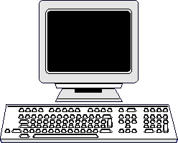
Computer Systems: Software
Single User Systems
Examples:
  DOS
  Windows
    95/98/ME
1-<number>

Slide 24
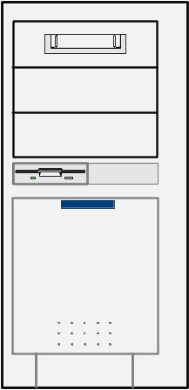
Computer Systems: Software
Multi-User Systems
Examples:
  Unix
  BSD
  Windows
    NT/2000/XP/Vista
  OS/X
1-<number>

Slide 25
Computer Systems: Software
Application Software
Application software refers to programs that make the computer useful to the user.
Application software provides a more specialized type of environment for the user to work in.
Common application software:
  Spreadsheets
  Word processors
  Accounting software
  Tax software
  Games
1-<number>

Slide 26
Programming Languages
A program is a set of instructions a computer follows in order to perform a task.
A programming language is a special language used to write computer programs.
A computer program is a set of instructions that enable the computer to solve a problem or perform a task.
Collectively, these instructions form an algorithm
1-<number>

Slide 27
Programming Languages
An algorithm is a set of well defined steps to completing a task.
The steps in an algorithm are performed sequentially.
A computer needs the algorithm to be written in machine language.
Machine language is written using binary numbers.
The binary numbering system (base 2) only has two digits (0 and 1).
1-<number>

Slide 28
Programming Languages
The binary numbers are encoded as a machine language.
Each CPU has its own machine language.
  Motorola 68000 series processors
  Intel x86 series processors
  DEC Alpha processors, etc.
Example of a machine language instruction:
    1011010000000101
1-<number>

Slide 29
Programming Languages
In the distant past, programmers wrote programs in machine language.
Programmers developed higher level programming languages to make things easier.
The first of these was assembler.
Assembler made things easier but was also processor dependent.
1-<number>

Slide 30
Programming Languages
High level programming languages followed that were not processor dependent.
Some common programming languages:
Java
C
Visual Basic
BASIC
C++
Python
COBOL
C#
Ruby
Pascal
PHP
JavaScript
1-<number>

Slide 31
Programming Languages
Common Language Elements
There are some concepts that are common to virtually all programming languages.
Common concepts:
  Key words
  Operators
  Punctuation
  Programmer-defined identifiers
  Strict syntactic rules.
1-<number>

Slide 32
Programming Languages
Sample Program
public class HelloWorld
{
public static void main(String[] args)
{
String message = "Hello World";
System.out.println(message);
}
}
1-<number>

Slide 33
Programming Languages
Sample Program
Key words in the sample program are:
Key words are lower case (Java is a case sensitive language).
Key words cannot be used as a programmer-defined identifier.
  public
  class
  static
  void
1-<number>

Slide 34
Programming Languages
Semi-colons are used to end Java statements; however, not all lines of a Java program end a statement.
Part of learning Java is to learn where to properly use the punctuation.
1-<number>

Slide 35
Programming Languages
Lines vs Statements
There are differences between lines and statements when discussing source code.
System.out.println(
message);
This is one Java statement written using two lines. Do you see the difference?
A statement is a complete Java instruction that causes the computer to perform an action.
1-<number>

Slide 36
Programming Languages
Variables
Data in a Java program is stored in memory.
Variable names represent a location in memory.
Variables in Java are sometimes called fields.
Variables are created by the programmer who assigns it a programmer-defined identifier.
    example: int hours = 40;
In this example, the variable hours is created as an integer (more on this later) and assigned the value of 40.
1-<number>

Slide 37
Programming Languages
Variables
Variables are simply a name given to represent a place in memory.
0x000
0x001
0x002
0x003
0x004
0x005
0x006
0x007
1-<number>

Slide 38
Programming Languages
Variables
Assume that the this
variable declaration
has been made.
int length = 72;
0x000
The Java Virtual
Machine (JVM)
actually decides
where the value
will be placed
in memory.
0x001
0x002
0x003
72
0x004
The variable length
is a symbolic name
for the memory
location 0x003.
0x005
0x006
0x007
1-<number>

Slide 39
The Compiler and the Java Virtual Machine
A programmer writes Java programming statements for a program.
These statements are known as source code.
A text editor is used to edit and save a Java source code file.
Source code files have a .java file extension.
A compiler is a program that translates source code into an executable form.
1-<number>

Slide 40
The Compiler and the Java Virtual Machine
A compiler is run using a source code file as input.
Syntax errors that may be in the program will be discovered during compilation.
Syntax errors are mistakes that the programmer has made that violate the rules of the programming language.
The compiler creates another file that holds the translated instructions.
1-<number>

Slide 41
The Compiler and the Java Virtual Machine
Most compilers translate source code into executable files containing machine code.
The Java compiler translates a Java source file into a file that contains byte code instructions.
Byte code instructions are the machine language of the Java Virtual Machine (JVM) and cannot be directly executed directly by the CPU.
1-<number>

Slide 42
The Compiler and the Java Virtual Machine
Byte code files end with the .class file extension.
The JVM is a program that emulates a micro-processor.
The JVM executes instructions as they are read.
JVM is often called an interpreter.
Java is often referred to as an interpreted language.
1-<number>

Slide 43
Program Development Process
Text editor
Saves Java statements
Source code
(.java)
Is read by
Byte code
(.class)
Java compiler
Produces
Is interpreted by
Program
Execution
Java
Virtual
Machine
Results in
1-<number>

Slide 44
Portability
Portable means that a program may be written on one type of computer and then run on a wide variety of computers, with little or no modification.
Java byte code runs on the JVM and not on any particular CPU; therefore, compiled Java programs are highly portable.
JVMs exist on many platforms:
Windows
Mac
Linux
Unix
BSD
Etc.
1-<number>

Slide 45
Portability
With most programming languages, portability is achieved by compiling a program for each CPU it will run on.
Java provides an JVM for each platform so that programmers do not have to recompile for different platforms.
1-<number>

Slide 46
Portability
Byte code
(.class)
Java Virtual
Machine for Windows
Java Virtual
Machine for Unix
Java Virtual
Machine for Linux
Java Virtual
Machine for Mac
1-<number>

Slide 47
Java Versions
The software you use to write Java programs is called the Java Development Kit, or JDK.
There are different editions of the JDK:
  Java SE - Java2 Standard Edition.
  Java EE - Java2 Enterprise Edition.
  Java ME - Java2 Micro Edition.
Available for download at
http://java.sun.com
1-<number>

Slide 48
Compiling a Java Program
The Java compiler is a command line utility.
The command to compile a program is:
    java filename.java
javac is the Java compiler.
The .java file extension must be used.
  Example: To compile a java source code file named Payroll.java you would use the command:
    javac Payroll.java
1-<number>

Slide 49
The Programming Process
1. Clearly define what the program is to do.
2. Visualize the program running on the computer.
3. Use design tools to create a model of the program.
4. Check the model for logical errors.
1-<number>

Slide 50
The Programming Process
5. Enter the code and compile it.
6. Correct any errors found during compilation.
  Repeat Steps 5 and 6 as many times as necessary.
7. Run the program with test data for input.
8. Correct any runtime errors found while running the program.
  Repeat Steps 5 through 8 as many times as necessary.
9. Validate the results of the program.
1-<number>

Slide 51
Software Engineering
Encompasses the whole process of crafting computer software.
Software engineers perform several tasks in the development of complex software projects.
  designing,
  writing,
  testing,
  debugging,
  documenting,
  modifying, and
  maintaining.
1-<number>

Slide 52
Software Engineering
Software engineers develop:
  program specifications,
  diagrams of screen output,
  diagrams representing the program components and the flow of data,
  pseudocode,
  examples of expected input and desired output.
1-<number>

Slide 53
Software Engineering
Software engineers also use special software designed for testing programs.
Most commercial software applications are large and complex.
Usually a team of programmers, not a single individual, develops them.
Program requirements are thoroughly analyzed and divided into subtasks that are handled by
  individual teams
  individuals within a team.
1-<number>

Slide 54
Procedural Programming
Older programming languages were procedural.
A procedure is a set of programming language statements that, together, perform a specific task.
Procedures typically operate on data items that are separate from the procedures.
In a procedural program, the data items are commonly passed from one procedure to another.
1-<number>

Slide 55
Procedural Programming
Data Element
Procedure A
Procedure B
1-<number>

Slide 56
Procedural Programming
In procedural programming, procedures are developed to operate on the program’s data.
Data in the program tends to be global to the entire program.
Data formats might change and thus, the procedures that operate on that data must change.
1-<number>

Slide 57
Object-Oriented Programming
Object-oriented programming is centered on creating objects rather than procedures.
Objects are a melding of data and procedures that manipulate that data.
Data in an object are known as attributes.
Procedures in an object are known as methods.
1-<number>

Slide 58
Object-Oriented Programming
Object
Attributes (data)
Methods
(behaviors / procedures)
1-<number>

Slide 59
Object-Oriented Programming
Object-oriented programming combines data and behavior via encapsulation.
Data hiding is the ability of an object to hide data from other objects in the program.
Only an objects methods should be able to directly manipulate its attributes.
Other objects are allowed manipulate an object’s attributes via the object’s methods.
This indirect access is known as a programming interface.
1-<number>

Slide 60
Object-Oriented Programming
Object
Programming
Interface
Attributes (data)
typically private to this object
Methods
(behaviors / procedures)
Other
objects
1-<number>

